Slide 1
College of Arts and Architecture
Faculty Council
March 3, 2021
Katherine Allen, Associate General Counsel
Office of General Counsel
Kathy Bieschke, Vice Provost for Faculty Affairs

Slide 2
Academic Freedom
Elusive Concept – defined differently by faculty, universities, courts
1940 Statement of Principles on Academic Freedom and Tenure
Universities’ Rights: who may teach, what may be taught, how it shall be taught, who may be admitted to study
Students’ Rights: rooted in free speech
Faculty Rights and Responsibilities - University Academic Policy 64

Slide 3
Academic Freedom for Faculty – AC 64
Rights & Responsibilities
Teaching, Research, and Support Duties
As a citizen
As related to the University
In Research and Publication
As Instructors

Slide 4
AC64 Academic Freedom
PURPOSE:
To outline the conditions of academic freedom for faculty members. Academic freedom refers to the environment provided by the University that permits faculty members to engage in their scholarly pursuits of teaching, research, and related activities at institutions of higher education. Academic freedom thus embodies the conditions necessary for the University to fulfill its mission of creating new knowledge and of effectively communicating accumulated knowledge and understanding to students and to the community at large. Academic responsibility refers to the duty and obligation of all faculty to pursue their academic pursuits with forthrightness, recognizing that while all members of the University have the right to express their own views and to hear the views of others expressed, as well as the responsibility for according the same rights to others, they also have a duty to make it clear when they are not speaking for the institution in matters of public interest. The University should be an institution whose members may express themselves, while protecting and respecting the rights of others to learn, to do research, and to carry out the essential functions of the University free from interference or obstruction.

Slide 5
AC64 AS A CITIZEN:
Faculty members are citizens, members of learned professions, and representatives of this University. When the faculty member speaks or writes as a citizen, the faculty member shall be free from institutional censorship or discipline, but the special position in the community held by the faculty member imposes special obligations. As a person of learning and an educator, the faculty member is expected to remember that the public may judge the profession and institution by his/her utterances. Hence, the faculty member agrees at all times to be accurate, to exercise appropriate restraint, to show respect for the opinions of others, and to make every effort to indicate that he/she is not an institutional spokesperson.

Slide 6
AS RELATED TO THE UNIVERSITY:
The efficient operation of any institution requires cooperation among its personnel. The faculty member agrees, therefore, to abide by the regulations of the University, and to perform to the best of his/her ability such reasonable duties as are assigned by authorized University officials. Faculty members are free to speak and write on governance issues of their respective departments, colleges, units, libraries, and of the University as a whole, and are free to speak and write on all matters related to their professional duties without institutional discipline or restraint. Similarly, faculty members recognize that they are expected to exercise professional responsibility in their service roles. Faculty members are responsible for respecting confidentiality and the privacy rights of others.

Slide 7
IN RESEARCH AND PUBLICATION:
Faculty members are free to engage in research or scholarship of their own undertaking, and in the publication of the results, subject to the adequate performance of other academic duties. Research conducted for this University shall be in harmony with the provisions set forth in the official research policies of the institution, or in memoranda of agreement entered into between the University and industries or other agencies. Librarians are free to select and make available any materials supporting the teaching, research, and general learning functions of the academic community.

Slide 8
IN INSTRUCTIONAL ROLES:
Academic freedom is also inherent in faculty members' roles in the classroom and in related instructional activities. Faculty members are, however, responsible for the maintenance of appropriate standards of scholarship and teaching ability, and for ensuring that there is no insertion or intrusion of material that has no relation to the subject matter of instruction. Faculty members are expected to educate students to think for themselves, and to facilitate access to relevant materials that they need to form their own opinions. Faculty members are expected to present information fairly, and to set forth justly divergent opinions that arise out of scholarly methods and professionalism.
No faculty member may claim as a right the privilege of discussing in the classroom controversial topics outside or unrelated to his/her own field of study. The faculty member is normally bound not to take advantage of his/her position by introducing into the classroom provocative discussions of irrelevant subjects not within the field of his/her study.

Slide 9
APPEALS:
If a faculty member feels that his or her academic freedom rights have been violated, the procedure listed in the policy entitled, "Faculty Rights and Responsibilities" AC76 may be used.
CROSS REFERENCES:
AD47 - General Standards of Professional Ethics
AD92 – Political Campaign Activities

Slide 10
Case Study #1
Mathematics Professor Pye at Common College conducts a basic algebra course every Fall semester. For years, Dr. Pye has used class time to discuss politics and political candidates. Last year, he was reprimanded after students complained about his final exam that included extensive political and ideological commentary. Dr. Pye elected to teach in person in Fall 2020. During the first week of class, he removed his mask and told his students that he was actively protesting the government over-reach of COVID mitigation measures and the repression of his free choice.
What, if any, action can Common College take?

Slide 11
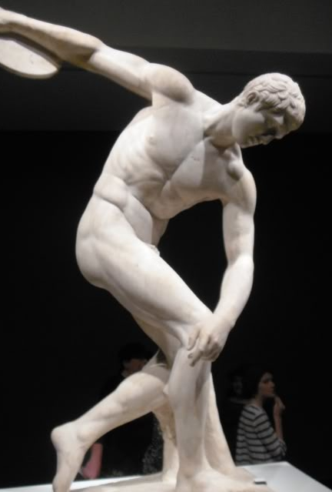
Case Study #2
In designing a course on ancient Greek civilizations , Professor Olive presents students with topical art from ancient Greek times, including nude images and a discussion regarding the changing view of the human body. Several students file a complaint against Professor Olive, objecting to the nudity and saying that it makes them uncomfortable. They say that Professor Olive knows that they are all religiously conservative and seems to target them with questions about nudity that he knows offends them.
What can/should the University do?
What can/should the Faculty Senate do to assist with such situations in the future?

Slide 12
Takeaways
Academic freedom = rights and responsibilities
AC64 describes academic freedom for Penn State faculty
If you’re unsure, ask

Slide 13
Still not sure? Ask!
Office of General Counsel
(814) 867-4088
Katherine Allen, KMA13@psu.edu
Office of the Vice Provost for Faculty Affairs
(814) 863-7494
Kathy Bieschke,
kxb11@psu.edu

